Slide 1
Using Remote Method Invocation to Implement Callbacks

Slide 2
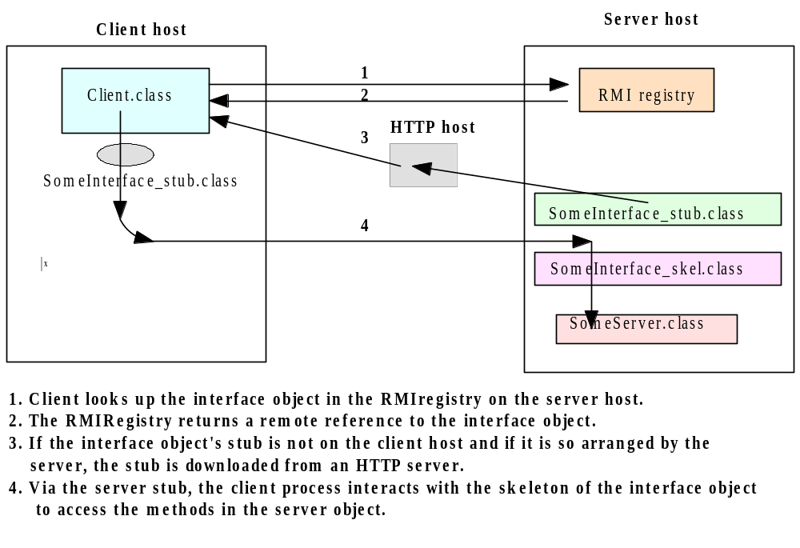
Java RMI Client Server Interaction

Slide 3
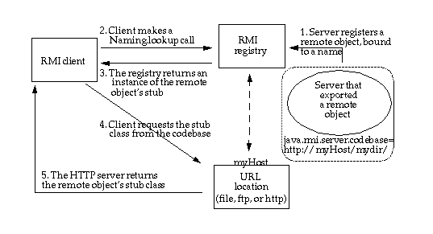
CodeBase
A codebase can be defined as a source, or a place, from which to load classes into a virtual machine

Slide 4
CodeBase
The remote object's codebase is specified by the remote object's server by setting the java.rmi.server.codebase property.The codebase set on the server VM is annotated to the remote object reference in the Java RMI registry.
The Java RMI client requests a reference to a named remote object. The reference (the remote object's stub instance) is what the client will use to make remote method calls to the remote object.
The Java RMI registry returns a reference (the stub instance) to the requested class. If the class definition for the stub instance can be found locally in the client's CLASSPATH , which is always searched before the codebase, the client will load the class locally. However, if the definition for the stub is not found in the client's CLASSPATH, the client will attempt to retrieve the class definition from the remote object's codebase.

Slide 5
CodeBase
The client requests the class definition from the codebase. The codebase the client uses is the URL that was annotated to the stub instance when the stub class was loaded by the registry.
The class definition for the stub (and any other class(es) that it needs) is downloaded to the client.
Now the client has all the information that it needs to invoke remote methods on the remote object. The stub instance acts as a proxy to the remote object that exists on the server;
In addition to downloading stubs and their associated classes to clients, the java.rmi.server.codebase property can be used to specify a location from which any class, not only stubs, can be downloaded.

Slide 6
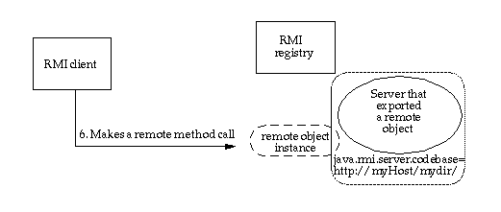
CodeBase
Java RMI client making a remote method call

Slide 7
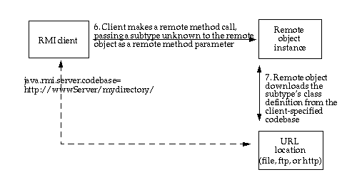
CodeBase
Java RMI client making a remote method call, passing an unknown subtype as a method parameter

Slide 8
Preparing for Deployment
Deploying an application that uses RMI can be tricky because so many things can go wrong and the error messages that you get when something does go wrong are so poor. Separate the class files into three subdirectories:
server
download
client
The server directory contains all files that are needed to run the server. You will later move these files to the machine running the server process. In our example, the server directory contains the following files:
server/
ProductServer.class
ProductImpl.class
Product.class

Slide 9
Preparing for Deployment
The client directory contains the files that are needed to start the client
client/
ProductClient.class
Product.class
client.policy
You will deploy these files on the client computer. Finally, the download directory contains those class files needed by the RMI registry, the client, and the server, as well as the classes they depend on. In our example, the download directory looks like this:
download/
ProductImpl_Stub.class
java - Djava.rmi.server.codebase = http://localhost:8080/ download/ ProductServer &

Slide 10
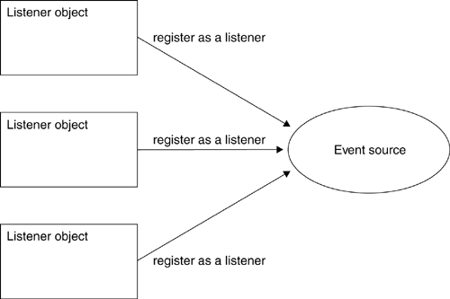
Using RMI to Implement Callbacks
Multiple listeners can register with one or more event sources.

Slide 11
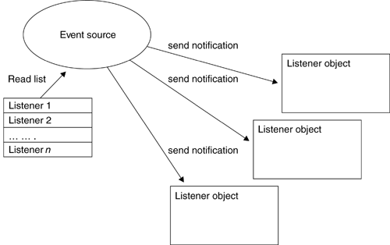
Using RMI to Implement Callbacks
Callback notification of event, for every registered listener

Slide 12
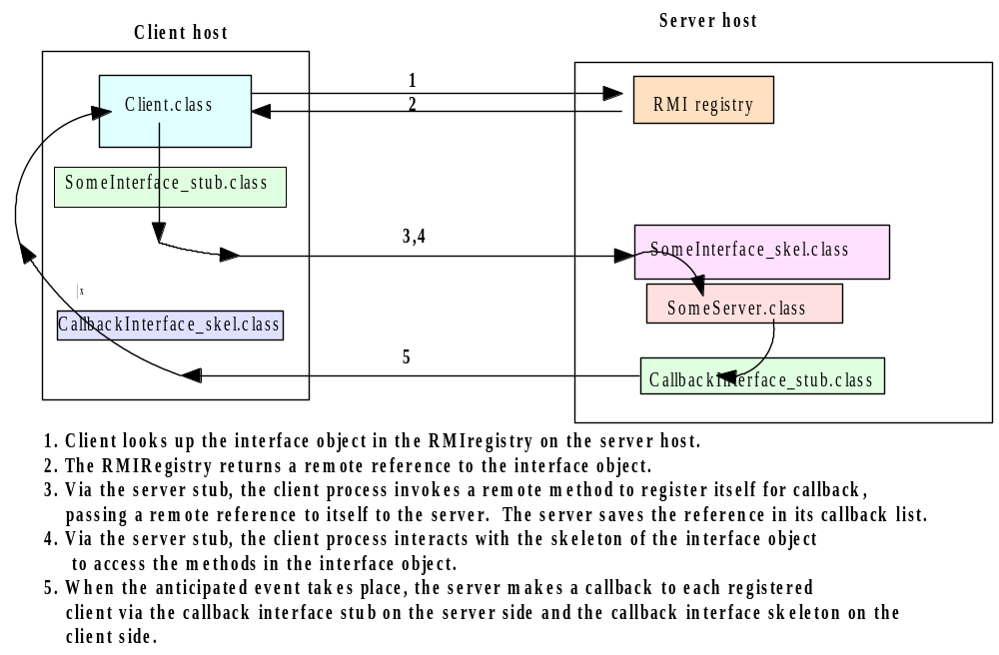
Callback Client-Server Interactions

Slide 13
Defining the Listener Interface
The listener interface defines a remote object with a single method. This method should be invoked by an event source whenever an event occurs, so as to act as notification that the event occurred. The method signifies a change in temperature, and allows the new temperature to be passed as a parameter.
interface TemperatureListener extends Remote {
public void temperatureChanged(double temperature)
throws java.rmi.RemoteException;
}

Slide 14
Defining the Event Source Interface
The event source must allow a listener to be registered and unregistered, and may optionally provide additional methods. In this case, a method to request the temperature on demand is offered.
interface TemperatureSensor extends java.rmi.Remote{
public double getTemperature()
throws java.rmi.RemoteException;
public void addTemperatureListener
(TemperatureListener listener )
throws java.rmi.RemoteException;
public void removeTemperatureListener
(TemperatureListener listener )
throws java.rmi.RemoteException;
}

Slide 15
Implementing the Event Source Interface
A TemperatureSensorServerImpl class is defined, which acts as an RMI server.
To notify registered listeners as a client (The server must extend UnicastRemoteObject, to offer a service, and implement the Temperature Sensor interface.
To create an instance of the service and registering it with the rmiregistry
To launch a new thread, responsible for updating the value of the temperature, based on randomly generated numbers.
As each change occurs, registered listeners are notified, by reading from a list of listeners stored in a java.util.Vector object. This list is modified by the remote addTemperatureListener(TemperatureListener) and removeTemperatureListener(TemperatureListener) methods.

Slide 16
Implementing the Event Source Interface
public class TemperatureSensorImpl extends UnicastRemoteObject implements TemperatureSensor, Runnable {
private volatile double temp; private Vector list = new Vector();
public TemperatureSensorImpl() throws java.rmi.RemoteException {
super();
temp = 98.0; // Assign a default setting for the temperature
}
public double getTemperature() throws java.rmi.RemoteException {
return temp;
}
public void addTemperatureListener(TemperatureListener listener)
throws java.rmi.RemoteException {
System.out.println("adding listener -" + listener);
list.add(listener);
}
public void removeTemperatureListener(TemperatureListener listener)
throws java.rmi.RemoteException {
System.out.println("removing listener -" + listener);
list.remove(listener);
}

Slide 17
Implementing the Event Source Interface
public void run() {
Random r = new Random();
for (; ; ) {
try {
// Sleep for a random amount of time
int duration = r.nextInt() % 10000 + 2000;
// Check to see if negative, if so, reverse
if (duration < 0) duration = duration * -1;
Thread.sleep(duration);
} catch (InterruptedException ie) {}
// Get a number, to see if temp goes up or down
int num = r.nextInt();
if (num < 0) temp += 0.5; else temp -= 0.5;
notifyListeners(); // Notify registered listeners
}}

Slide 18
Implementing the Event Source Interface
private void notifyListeners() {
// Notify every listener in the registered list
for (Enumeration e = list.elements(); e.hasMoreElements();) {
TemperatureListener listener = (TemperatureListener)
e.nextElement();
// Notify, if possible a listener
try {
listener.temperatureChanged(temp);
} catch (RemoteException re) {
System.out.println("removing listener -" + listener);
// Remove the listener
list.remove(listener);
} }
} }

Slide 19
Implementing the Listener Interface
The temperature monitor client must implement the TemperatureListener interface, and register itself with the remote temperature sensor service, by invoking the TemperatureSensor.addTemperatureListener (Temperature Listener) method.
By registering as a listener, the monitor client will be notified of changes as they occur, using a remote callback. The client waits patiently for any changes, and though it does not ever remove itself as a listener, functionality to achieve this is supplied by the
TemperatureSensor.removeTemperatureListener( TemperatureListener)
method.

Slide 20
Implementing the Listener Interface
import java.rmi.*;
import java.rmi.server.*;
public class TemperatureListenerImpl extends UnicastRemoteObject implements TemperatureListener {
// Default constructor throws a RemoteException
public TemperatureListenerImpl() throws RemoteException {
super();
}
public void temperatureChanged(double temperature) throws java.rmi.RemoteException {
System.out.println("Temperature change event : " + temperature);
}
}

Slide 21
TemperatureSensorServer
public class TemperatureSensorServer{
public static void main(String args[]) {
System.out.println("Loading temperature service");
try {
// Load the service
TemperatureSensorImpl sensor = new TemperatureSensorImpl();
// Register with service so that clients can find us
String registry = "localhost";
String registration = "rmi://" + registry + "/TemperatureSensor";
Naming.rebind(registration, sensor);
// Create a thread, and pass the sensor server. This will activate the //run() method, and trigger regular temperature changes.
Thread thread = new Thread(sensor);
thread.start();
} catch (RemoteException re) {
System.err.println("Remote Error - " + re);
} catch (Exception e) {
System.err.println("Error - " + e);
}
}}

Slide 22
TemperatureMonitor
public static void main(String args[]) {
System.out.println("Looking for temperature sensor");
try {
// Lookup the service in the registry, and obtain a remote service
String registry = "localhost";
String registration = "rmi://" + registry + "/TemperatureSensor";
Remote remoteService = Naming.lookup(registration);
// Cast to a TemperatureSensor interface
TemperatureSensor sensor = (TemperatureSensor) remoteService;
// Get and display current temperature
double reading = sensor.getTemperature();
System.out.println("Original temp : " + reading);
// Create a new monitor and register it as a listener with remote sensor
TemperatureListenerImpl monitor = new TemperatureListenerImpl();
sensor.addTemperatureListener(monitor);
} catch (RemoteException re) {
System.out.println("RMI Error - " + re);
} catch (Exception e) {
System.out.println("Error - " + e);
} }

Slide 23
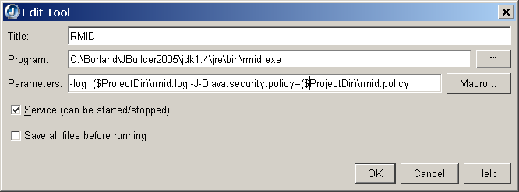
Configuring a RMID

